Slide 1
Universal Broadband
Mathews County
Broadband Telecom Services & Mathews Broadband Advisory Board 7/28/21 Board of Supervisor’ Meeting

Slide 2
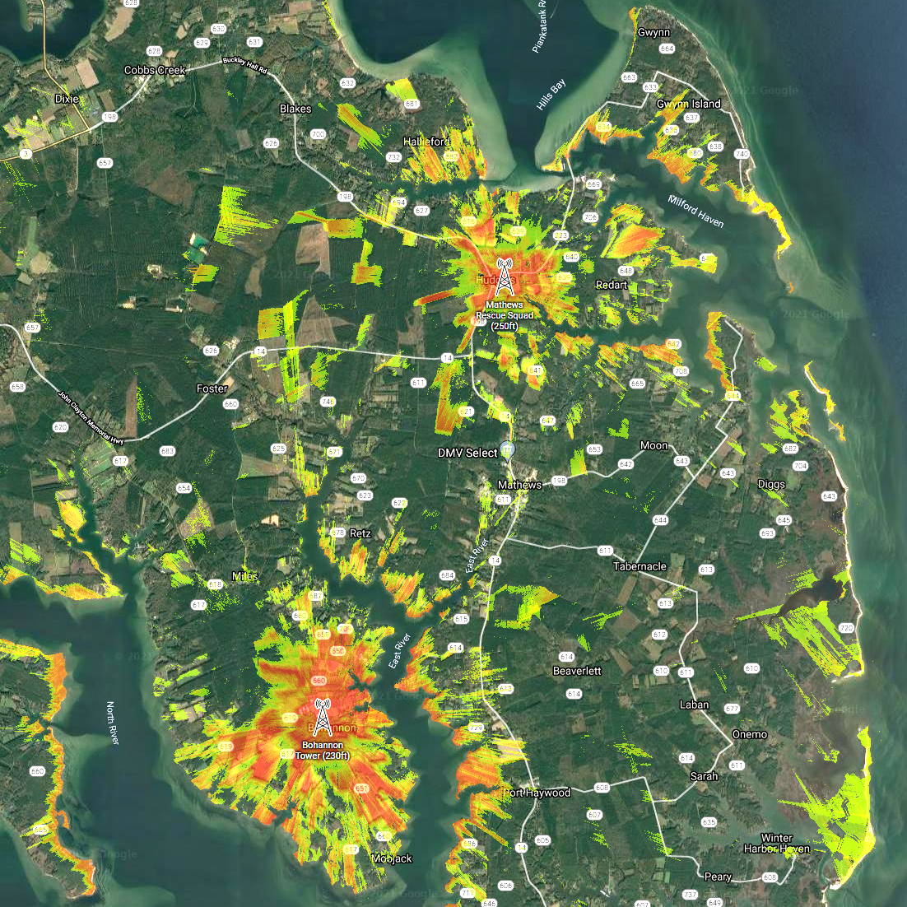
TWO TOWERS
TOWER AT
RESCUE SQUAD BUIDLING
TOWER AT
BOHANNON FIRE STATION
RESCUE
BOTH TOWERW

Slide 3
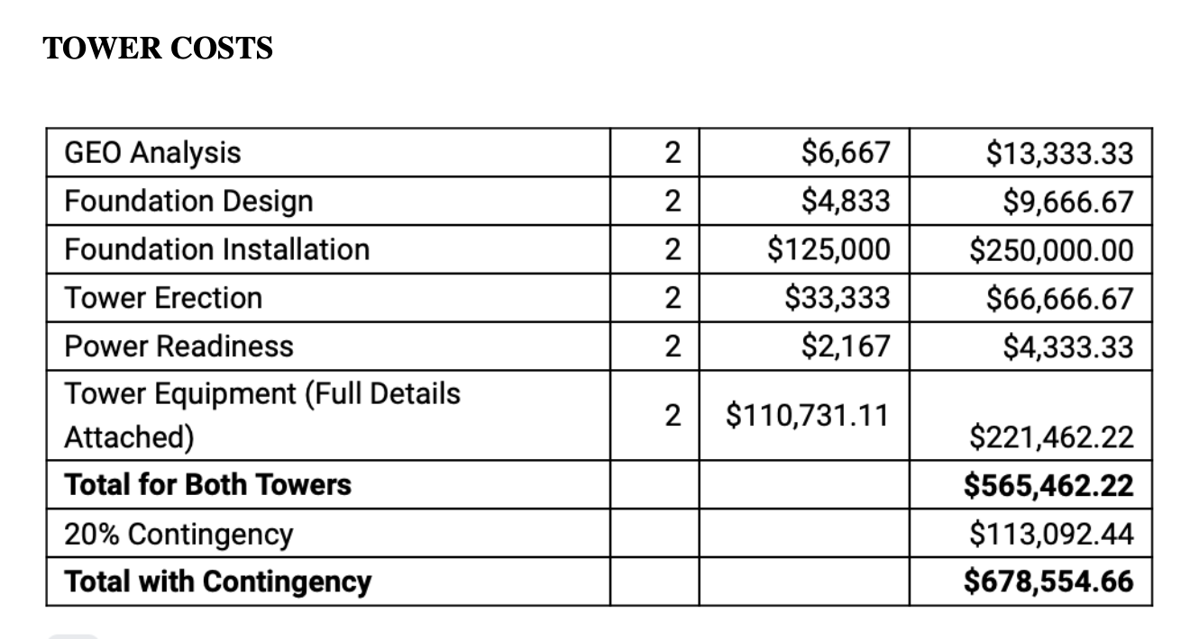

Slide 4
  Not To Exceed
Statement
  IN NO EVENT shall the amount payable for materials and equi[ment pertaining to the build and construction of the towers mentioned in “MATHEWS RF ANALYSIS-BTS” exceed SIX HUNDRED EIGHTY-SEVEN THOUSAND, FIVE HUNDRED FIFTY-FOUR DOLLARS AND SIXTY-SIX CENTS ($678,554.66). This dollar amount is not a guarantee that Mathews County will pay that full amount but id merely a limit of potential Mathews County expenditures under the agreement. This funding would come from the American Rescue Plan.

Slide 5
EXPANSION
FROM THE TOWERS:
REPEATERS
BRINGING ACCESS
TO ALL OF
MATHEWS COUNTY

Slide 6
Department of Housing and Community Development
2022 Virginia Telecommunication Initiative Grant
The Broadband Advisory Board with the help of Broadband Telecom Services will explore possibilities of funding for the expansion of service from the towers through this program again this year. This funding does require a match from the county.
We will come back to ask for your approval
when we have all the details.

Slide 7
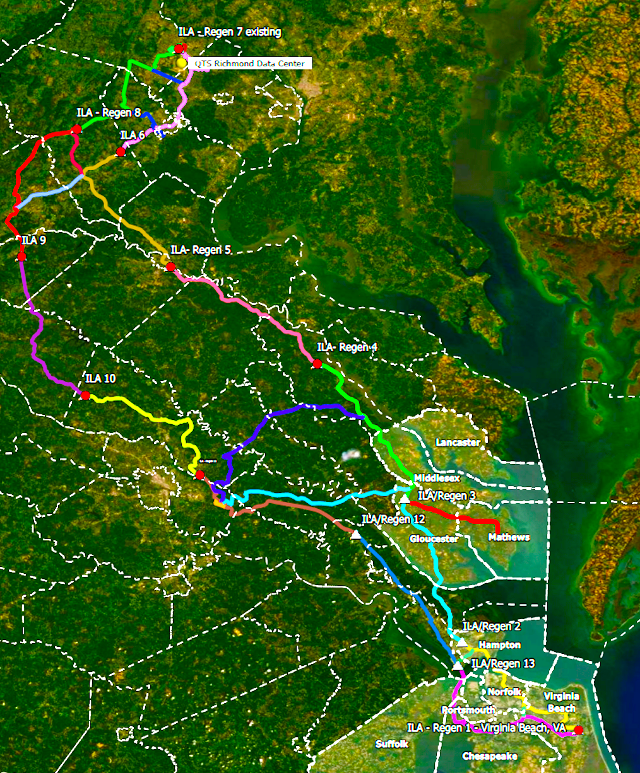
THE MUCH NEEDED,
LONG AWAITED
BACK HAUL
INTO
MATHEWS COUNTY

Slide 8
            Governor Ralph Northam
            Virginia to invest $700 million
            in American Rescue Plan funding
            to expedite the deployment
            of last-mile broadband infrastructure
            to unserved areas and close the digital divide
            in the next three years.
            The Governor’s goal is now
            to achieve universal broadband by 2024,
            the majority within the next 18 months.

Slide 9
100%
Universal Coverage!

